Slide 1
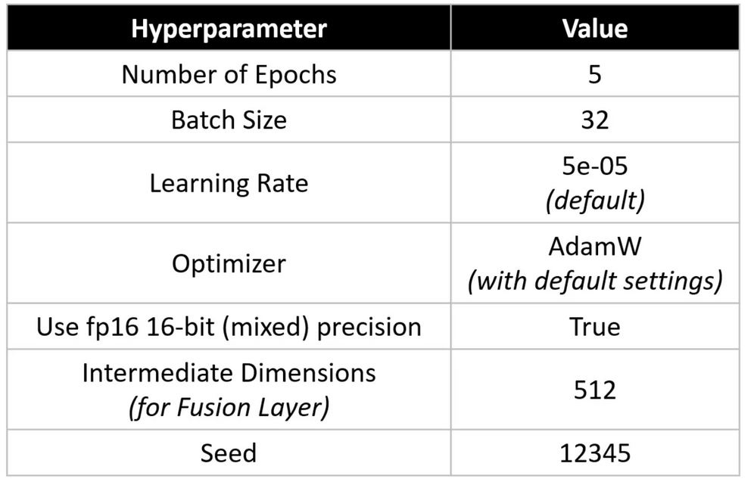
MEDICAL VQA
PROBLEM STATEMENT: Web based visual question answering transformer for medical images
TECH STACK: Transformer,Deeplearning,MERN,GPU,cloud
MODEL: fusion of bert and vit transformers
PAPER: Visual question answering with multimodal transformers
AUTHOR: Tezan Sahu
DATASET: PathVQA
(https://drive.google.com/drive/folders/1SLBdnhiReIbyYWbSqgIaPMM_GRZzuzAF?usp=sharing)
0

Slide 2
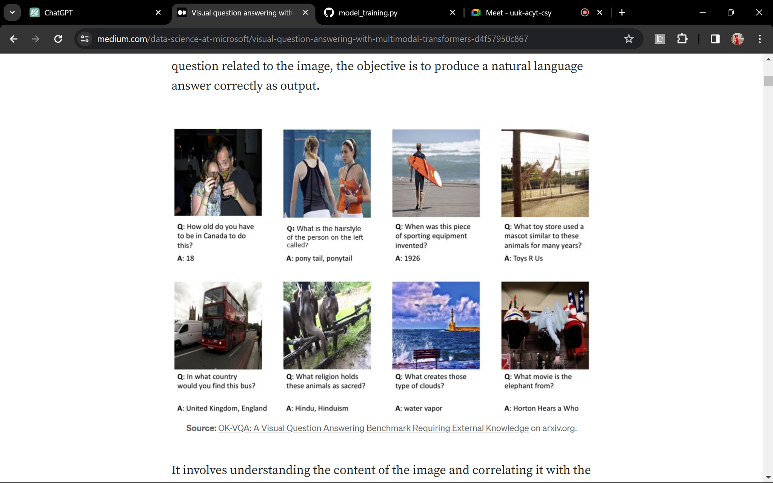
WHAT IS VQA?
VQA is a multimodal task wherein, given an image and a natural language question related to the image, the objective is to produce a natural language answer correctly as output.
IMPORTANCE OF VQA IN MULTIMODAL TASKS :
human-Computer Interaction Enhancement
Contextual Understanding
Cross-Modal Information Retrieval

Slide 3
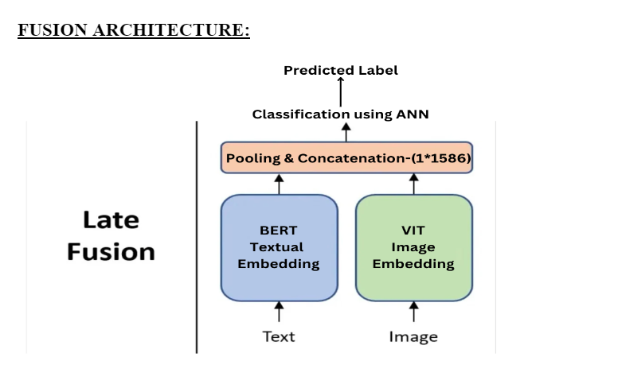
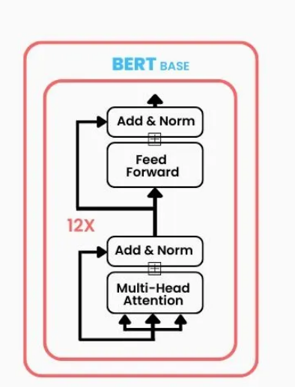
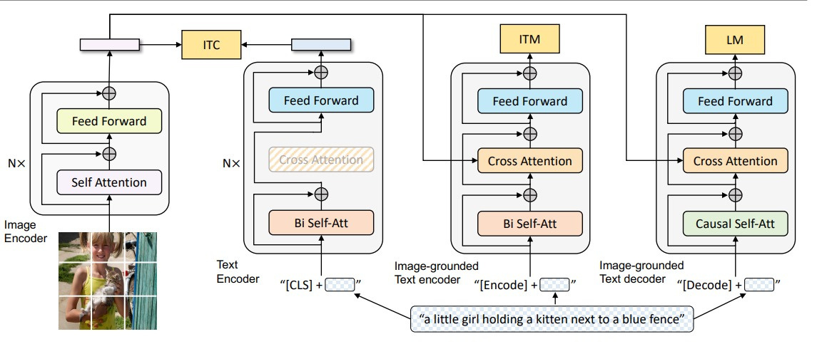

Slide 4
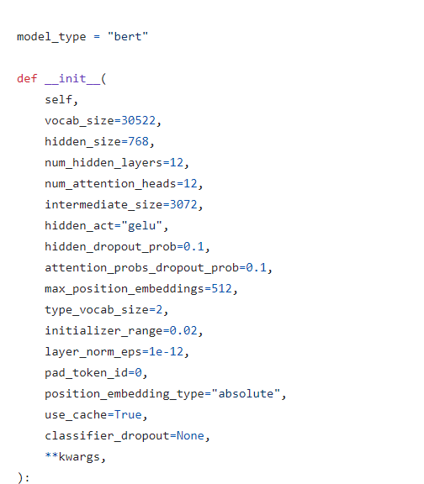
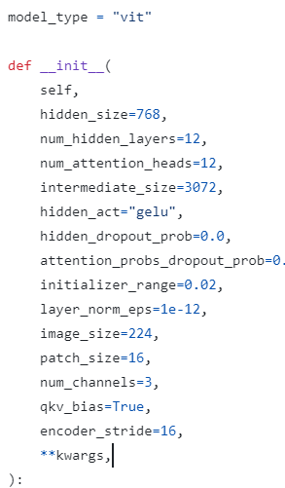

Slide 5


VISION EMBEDDINGS
Image Size = 224 * 224
Patch Size = 16 * 16
224
no of patches = 224* 224
= 14 * 14
__________
16 * 16
= 196 patches of each size (16 * 16)
Image
224
Kernel = ( 16 * 16)
16 * 16
( 16 * 16 ) kernel on (16 * 16) patch = 1 value
( 16 * 16 ) kernel on ( 224 * 224 ) image [for 1 i/p channel] = 1 * ( 14 * 14) feature map
16 * 16 ) kernel on ( 224 * 224 ) image [for 3 i/p channel] = 3 * ( 14 * 14) feature map
After adding 3 feature maps = 1 * ( 14 * 14 ) -> for 1 kernel
for 768 such kernels, we get 768 * ( 14 * 14 ) feature maps
After flattening (14 * 14) feature map we get ( 768 * 196 )
After transposing, we get ( 196 * 768 ) as out final vision embeddings
No. of attention heads = 12
Therefore, Attention head size = 768/12 = 64

Slide 6
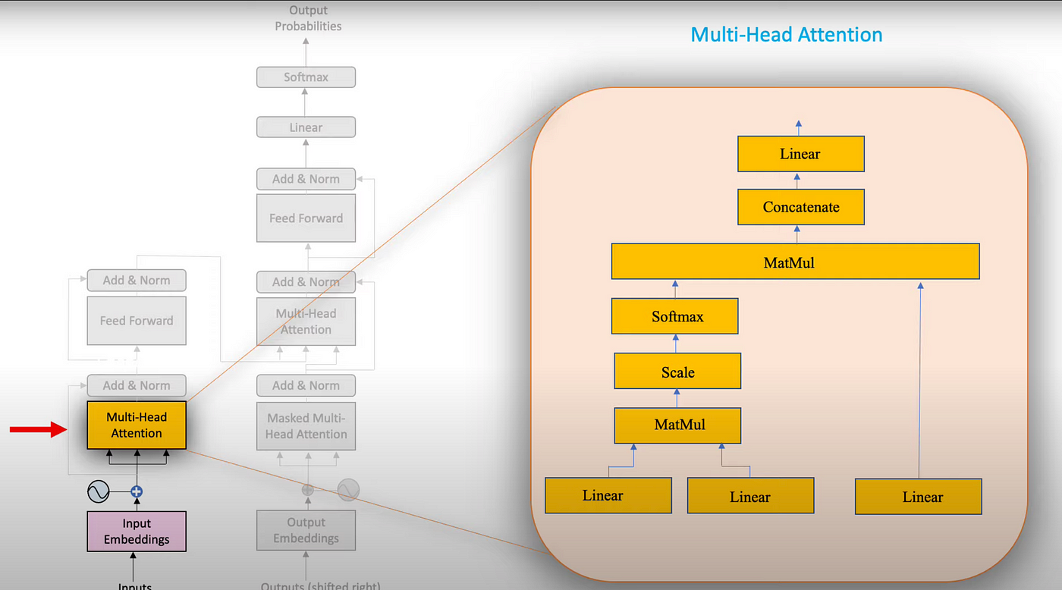


( 196 * 768) * ( 768 * 768 )
IMAGE SELF ATTENTION
= ( 197*768)
Concatinating 12 attention head values horizontally we get( 196 * 768)
( 196 * 768 )
T
( 196 * 768 )
QK
* V
= (196*196)X(196*64)
d
k
= ( 196 * 64)
( 196 * 64 )
T
QK
= Softmax( 196 * 196 )
( 196 * 196 )
d
k
T
= ( 196 * 196 )
( 196 * 196 )
QK
d
64
k
( 196 * 196 )
= ( 196 * 196 )
T
QK
= ( 196* 64 ) X (64 * 196)
= ( 196 * 196 )
( 196 * 64)
( 576 * 64 )
( 196 * 64)
( 196 * 64)
( 576 * 64 )
( 576 * 64 )
Query
Key
Value

Slide 7
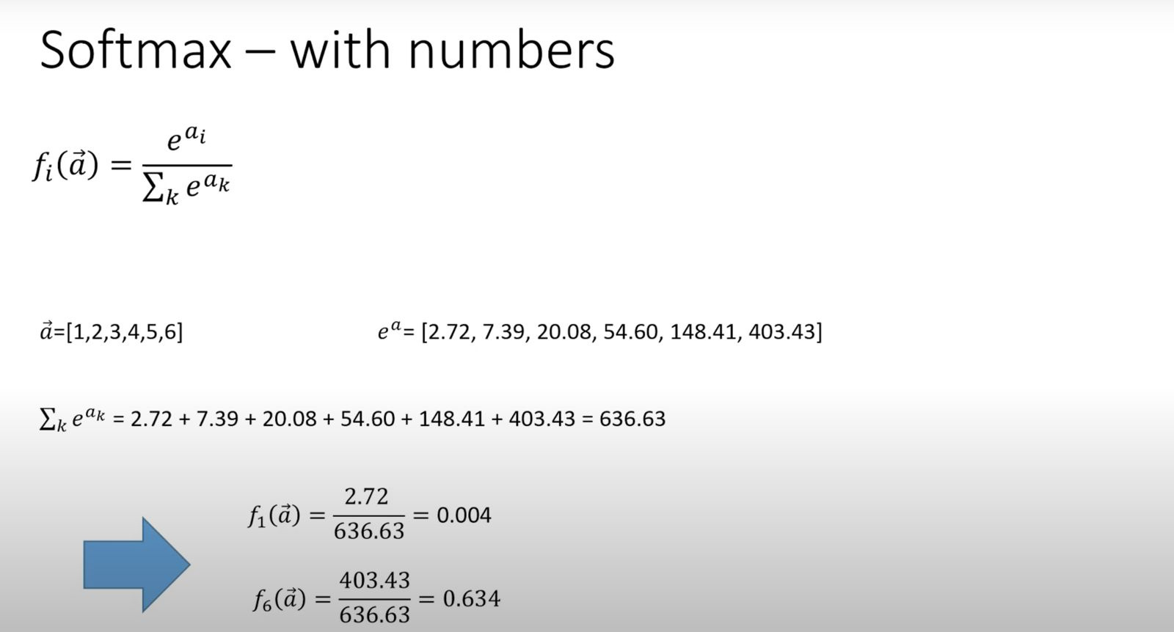

Slide 8
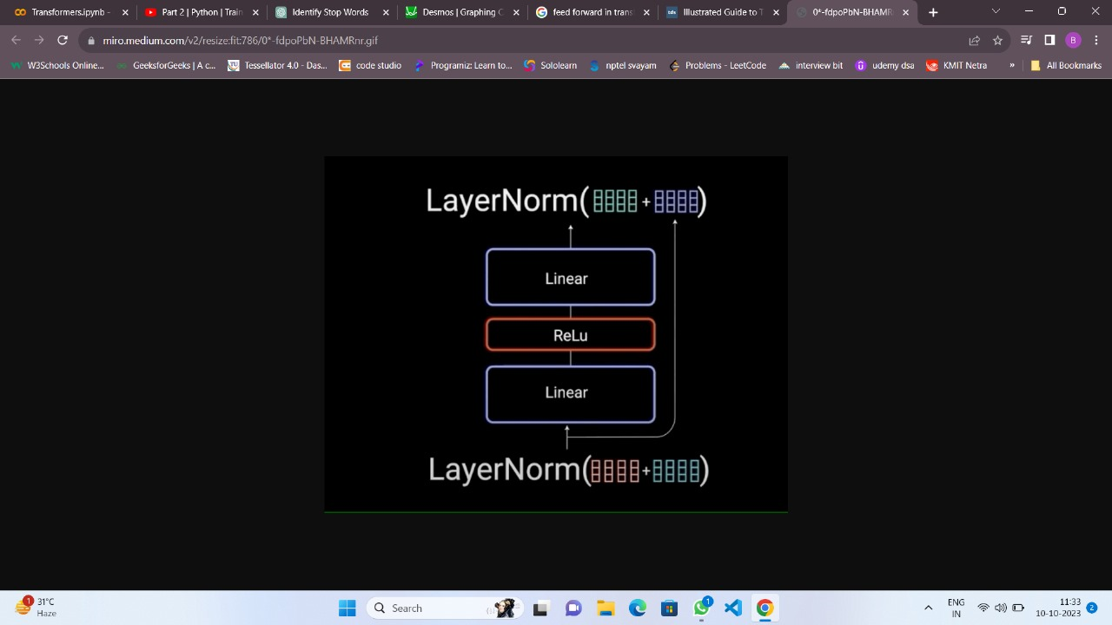
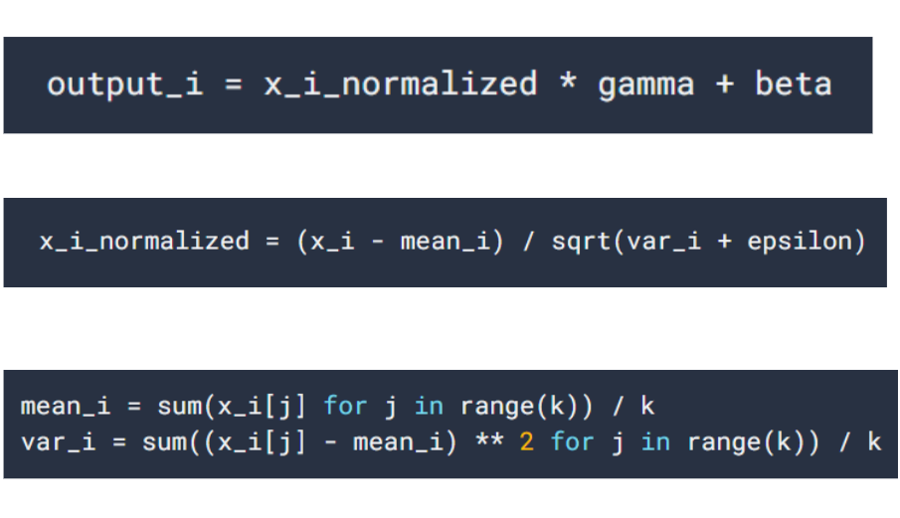
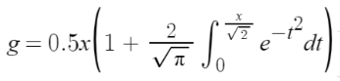
FEED FORWARD
= ( 196*3072) * (3072 * 768)
= (196* 768)
GELU
GELU( 196 * 3072)
= ( 196*768) * (768 * 3072)
= (196 * 3072)
GELU = Gaussian Error Linear Unit =

Slide 9
( 5* 768) * ( 768 * 768 )
SELF ATTENTION (TEXT)
= ( 5*768)
Cocatinating 8 attention head values horizontally we get(5 * 768)
T
QK
* V
= (5*5)X(5*96)
d
k
= ( 5* 96)
T
QK
= Softmax( 5* 5)
d
k
T
= ( 5 * 5 )
QK
d
96
k
= ( 5 * 5 )
T
QK
= ( 5 * 96 ) X (96 * 5)
( 20 * 96)
Query
( 20 * 96)
Key
( 20 * 96)
Valu
= ( 5 * 5 )
( 576 * 64 )
( 576 * 64 )
( 576 * 64 )

Slide 10
= ( 5*3072) * (3072 * 768)
= (5* 768)
GELU
GELU( 5 * 3072)
= ( 5*768) * (768 * 3072)
= (5 * 3072)

Slide 11
pooler output
of text
pooler output of image
1*768
1*768
concatenation
of text and image
1*1536

Slide 12
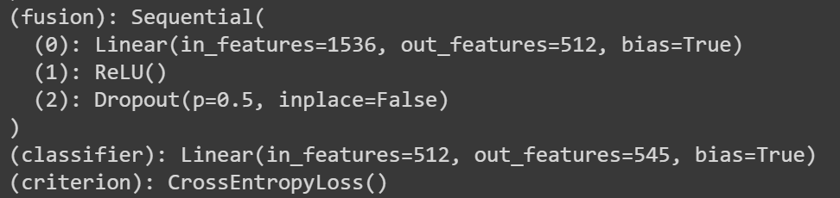

Slide 13
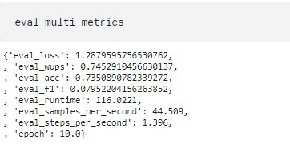
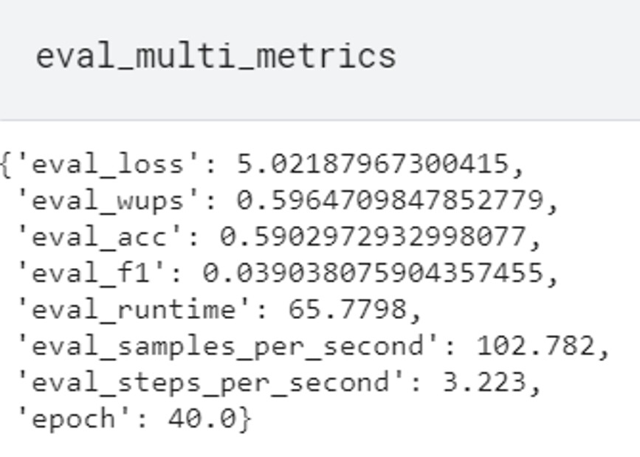
one word
one word & descriptive

Slide 14
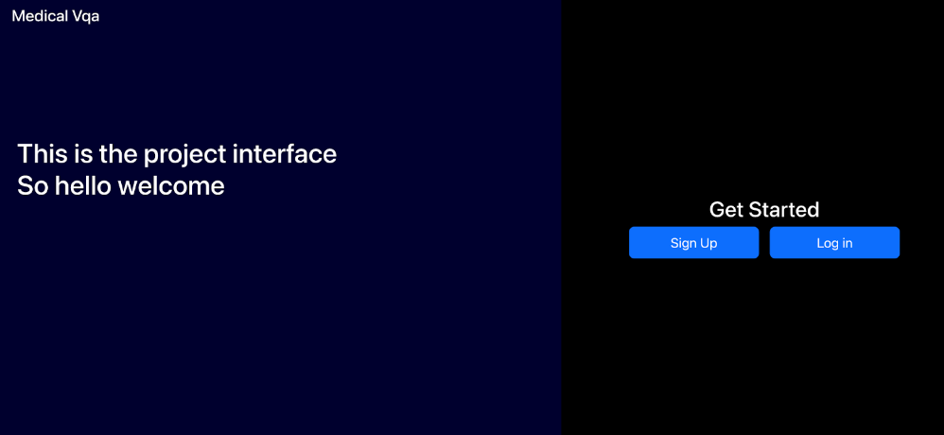

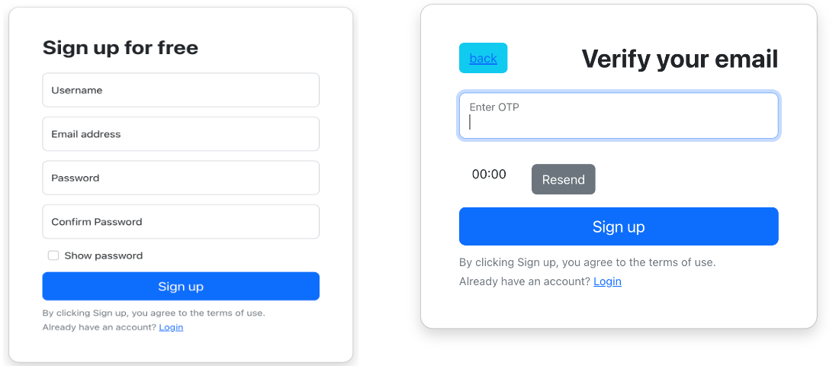

Slide 15
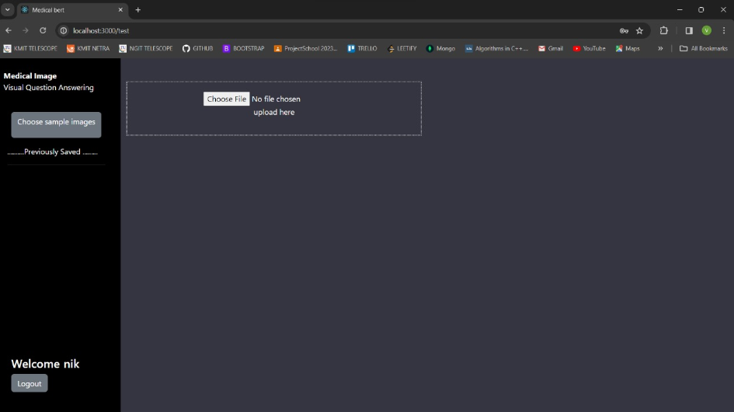
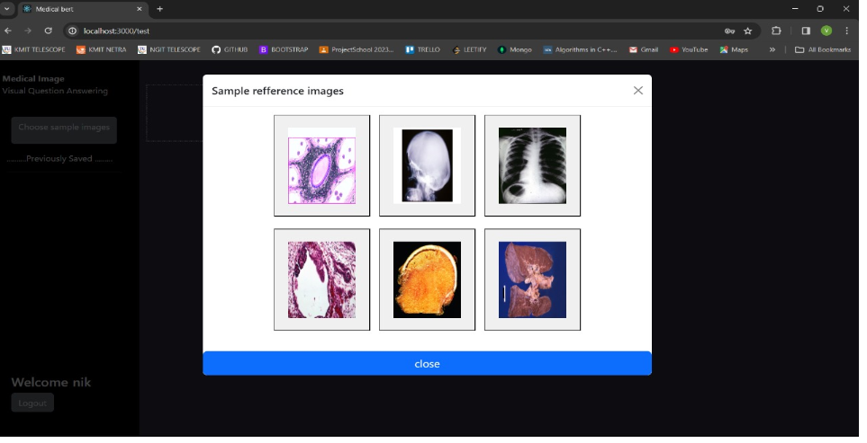
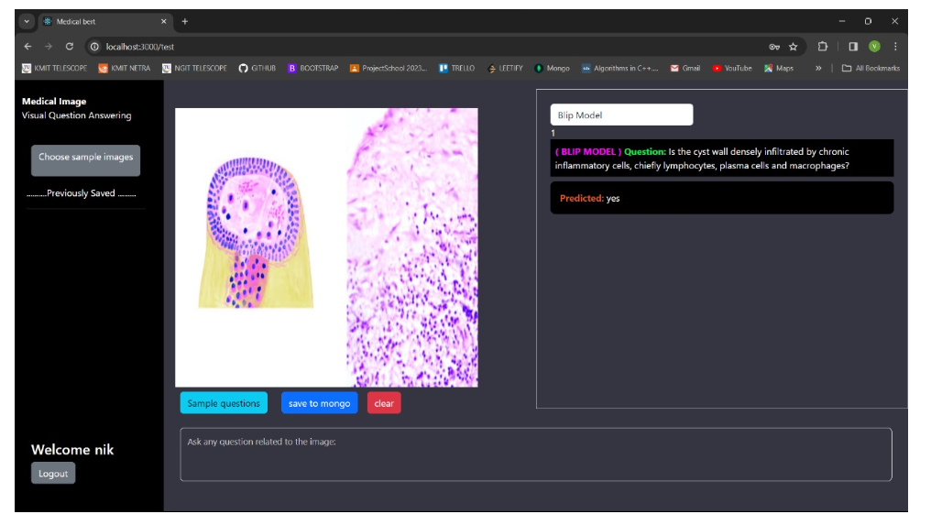
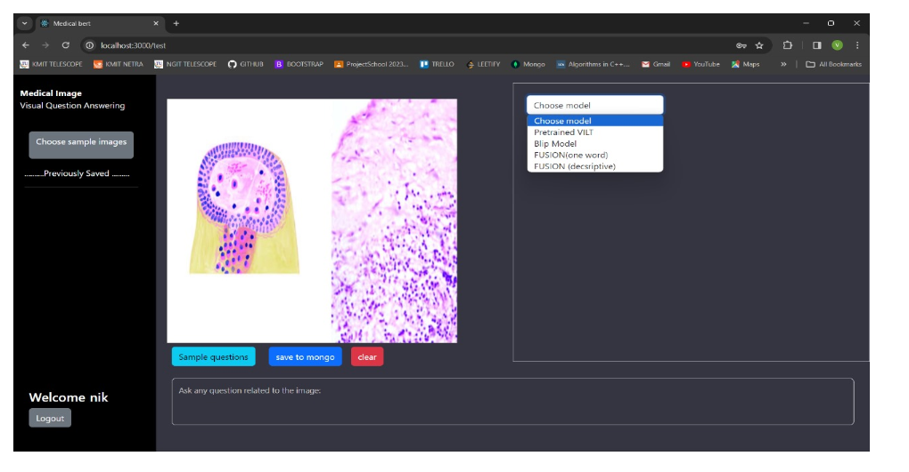

Slide 16
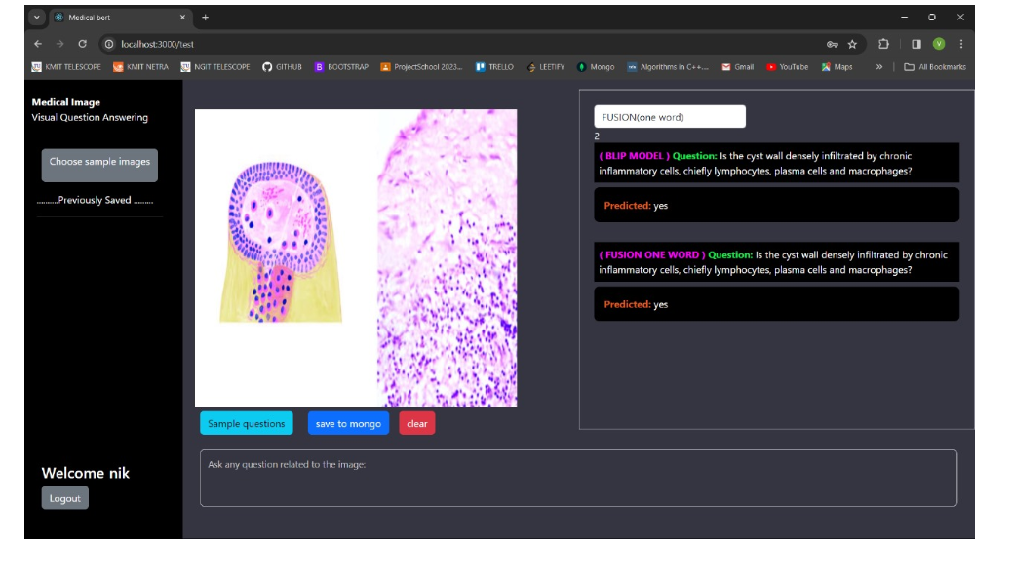
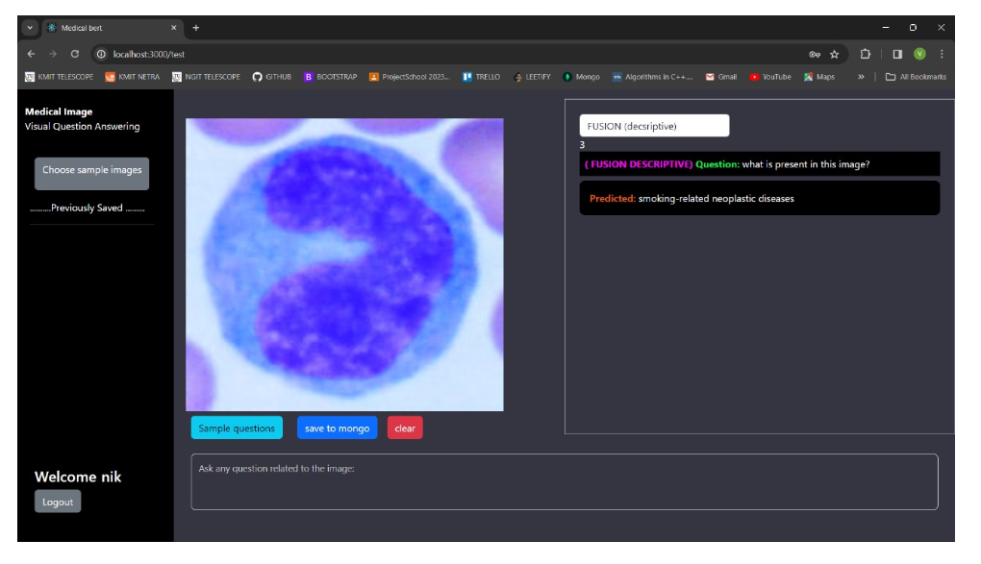

Slide 17
Real life usage :
Virtual Assistants
E-commerce Product Search
Educational Tools
Telemedicine
Live question answering

